Slide 1


THE EMPLOYMENT COMMONS
Payroll, Benefits & Shared Services for the Independent Worker
A Member-Owned Digital Employment Cooperative
2021

Slide 2



WORKERS MOVING TO INDEPENDENCE
130M
90M
57M
Contractors / Freelance
Full Time (W2) Employees
2019 2025 2028
Total US Labor Force (2020) 160M (2019)
Full Time Employees in US 130M (2019)
Freelancers/Contractors in US 57M (2019)
Projected Freelancers/Contractors 90M (2028)
Source: https://www.statista.com/statistics/921593/gig-economy-number-of-freelancers-us/

Slide 3

EXISTING TECHNOLOGY & FRAMEWORKS B2B
Employment frameworks & HR Tech are designed for corporations, not individuals
Workers desire freedom and flexibility
Employers desire less risk and lower costs
Existing systems for employment do not support either goal

Slide 4

WHAT IS OPOLIS?
A Digital Employment Cooperative offering independent workers fully portable benefits, payroll, & shared services while maintaining 100% compliance.

Slide 5

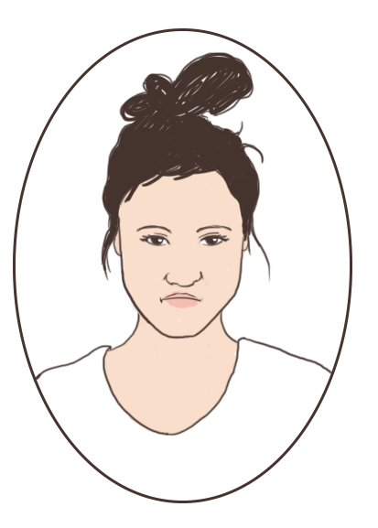






Meet Emily: Employment Isn’t Built for Freelancers Like Her
Loves the Flexibility of being a Freelancer
As an individual consumer, she has zero purchasing power for health insurance & related benefits
Her health benefits costs are $3600/year more than when she was W2
Spends $3K+/year for 3 different softwares and 3 different advisors to handle back-office, compliance, retirement, payroll, insurances & tax filings
Has 6 customers at any one time; juggles up to 30 revenue streams annually
Has 401(k)s from 2 former employers with nowhere to consolidate them
Occupation: Software Developer Experience: 6 Years
Employment: Freelance/Gig
Customer Location: Global
# Customers: 12-30 Annually

Slide 6

The Opolis Commons: Worker-Centric Employment Solutions
1-stop shop: Emily receives compliance, benefits, payroll, insurances & tax filings completed in a single platform, saving $3000 per year
She receives services tailored to individuals, not businesses
Consolidated her 401(k)s into a single account she controls
Emily found a health insurance plan better than what she could buy on a state exchange at 30% less in monthly cost
Doesn’t have to become an employee of Lyft when she drives for them on the weekends (satisfies AB5, ACA and other compliance rules)
All of her income from various streams can flow into one W2 paycheck

Slide 7







COMPREHENSIVE
MEMBER BENEFITS
Premium Group Medical & VSP Vision (BCBS)
Group Dental Insurance (United)
Customizable PTO & Holiday Policy (optional)
Insurances: life, long-term disability, short-term disability
Retirement: group 401(k), Individual 401k, Roth/Traditional IRA
FSA (Flexible Spending) / HSA (Health Savings)
Health & Wellness Stipends
Digital Currency Options
Benefits mirror the experience of traditional W2 employment

Slide 8


SHARED
SERVICES
100% Compliant with
U.S. Labor Laws
PAYROLL
Pay in &
Receive Crypto
Receive Annual W2
Semi-Monthly Payroll
Processing
Direct Deposit
PTO Tracking
& Processing
Tokenized Rewards for Consumption
COMPLIANCE
AB5 Compliant
Withholding & Tax Filings
Unemployment Filing
& Claims Administration
Garnishments
Employment
Eligibility Verifications
ACA Compliant Benefits
FLSA Compliant
EMPLOYMENT RISK
Commons Provides ‘Employer of Record’
Workers Compensation
Insurance: $1M
Access to Liability Insurance

Slide 9

EMPLOYMENT & PAYROLL = KILLER APP
The single common thread for all humans
in their commercial experience.
The single most important channel for mass adoption
of Web3 tech & cryptocurrencies.

Slide 10
COMPETITIVE LANDSCAPE (Raised $) | Gusto ($516M) | TriNet ($440M) | JustWorks ($143M) | Catch ($8M) | Flock ($5.5M) | Opolis (Raising $1.5M)
Payroll & Compliance | ✔ | ✔ | ✔ | ✔ | ✔ | ✔
Employer of Record (EOR) | ✘ | ✔ | ✔ | ✘ | ✘ | ✔
Group Healthcare (ACA) | ✘ | ✔ | ✔ | ✘ | ✘ | ✔
Worker/User Centric (B2C) | ✘ | ✘ | ✘ | ✔ | ✔ | ✔
Network-Based Governance | ✘ | ✘ | ✘ | ✘ | ✘ | ✔
Shared Services Integration | ✔ | ✔ | ✔ | ✘ | ✘ | ✔
EOR Follows User (not Corp) | ✘ | ✘ | ✘ | ✘ | ✘ | ✔
Tokenized Rewards | ✘ | ✘ | ✘ | ✘ | ✘ | ✔
* Lead Investor Fidelity General Atlantic USV Khosla Hartford

Slide 11


$WORK REWARDS SCALES MEMBERS & VALUE
(Tokenomics Paper Here)
$WORK incentivizes Members to consume services & make referrals
Patronage unit of account to determine share of dividends/future profits for Members
“Payroll Mining” block rewards distributed based on payroll volume growth thresholds
Members stake tokens to earn enhanced governance and additional $WORK tokens
Launching Q1 2021 immediately following Seed II Equity round completion
Employee Members, Coalition Members, & Trustee Stakeholders (Team, Tech Contributors, Advisors & Investors) receive $WORK for value contributions
No tokens will be sold

Slide 12












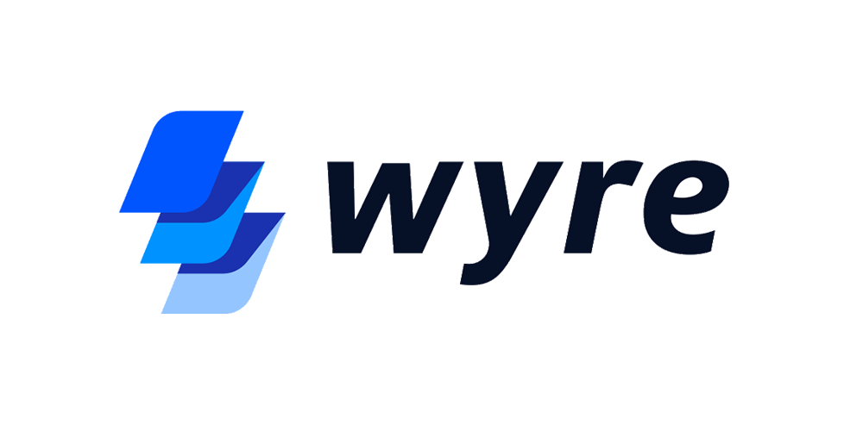
























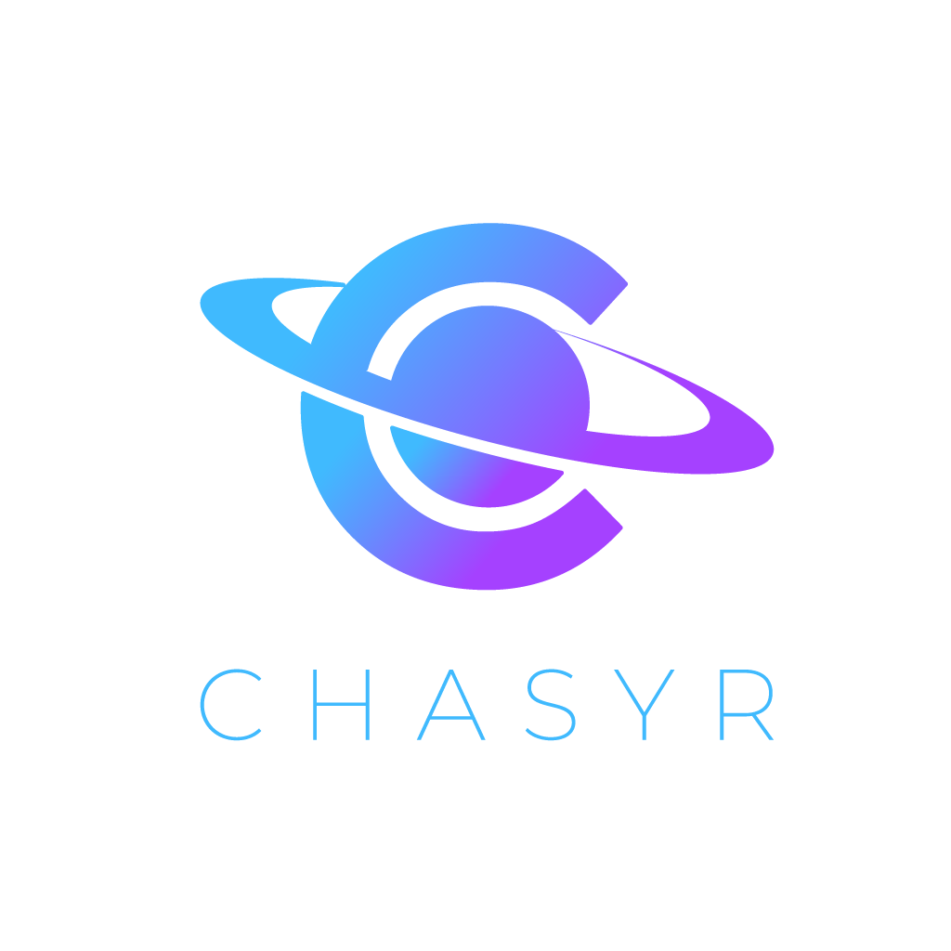










COALITION FOR THE SELF-SOVEREIGN WORKER
🐋

Slide 13
Traction & Product/Market Fit
Annual Commons Payroll Volume (ACPV): March21 ACPV - $3.4MM; ~Est April21 - $4.9MM
Active Employee Members (including April 2021): 62
Legal Framework Built: Platform prepared to onboard employees in several states
Currently focused on California, Colorado, Oregon, Tennessee
9:10 prospective Members who meet with Membership Steward signal intent to join
To date, 100% of active Members are due to referrals

Slide 14

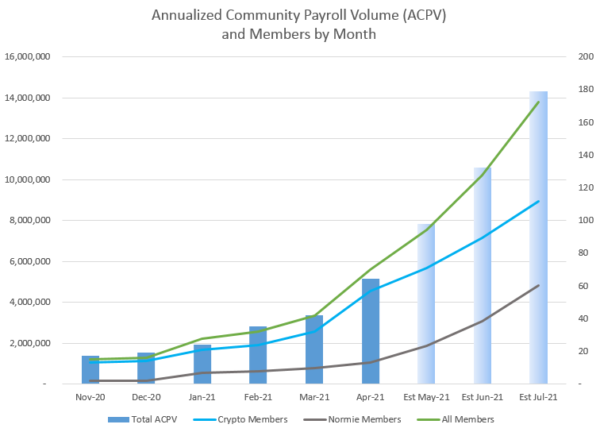
Accelerated ACPV Growth
28 New Members in April 2021
Est 35%+ MoM Growth Projections through 2021
150+ “YES” Individuals in Onboarding
300+ Members by EOY 2021
EOY EST ACPV ~40M
$WORK launch designed for explosive growth

Slide 15
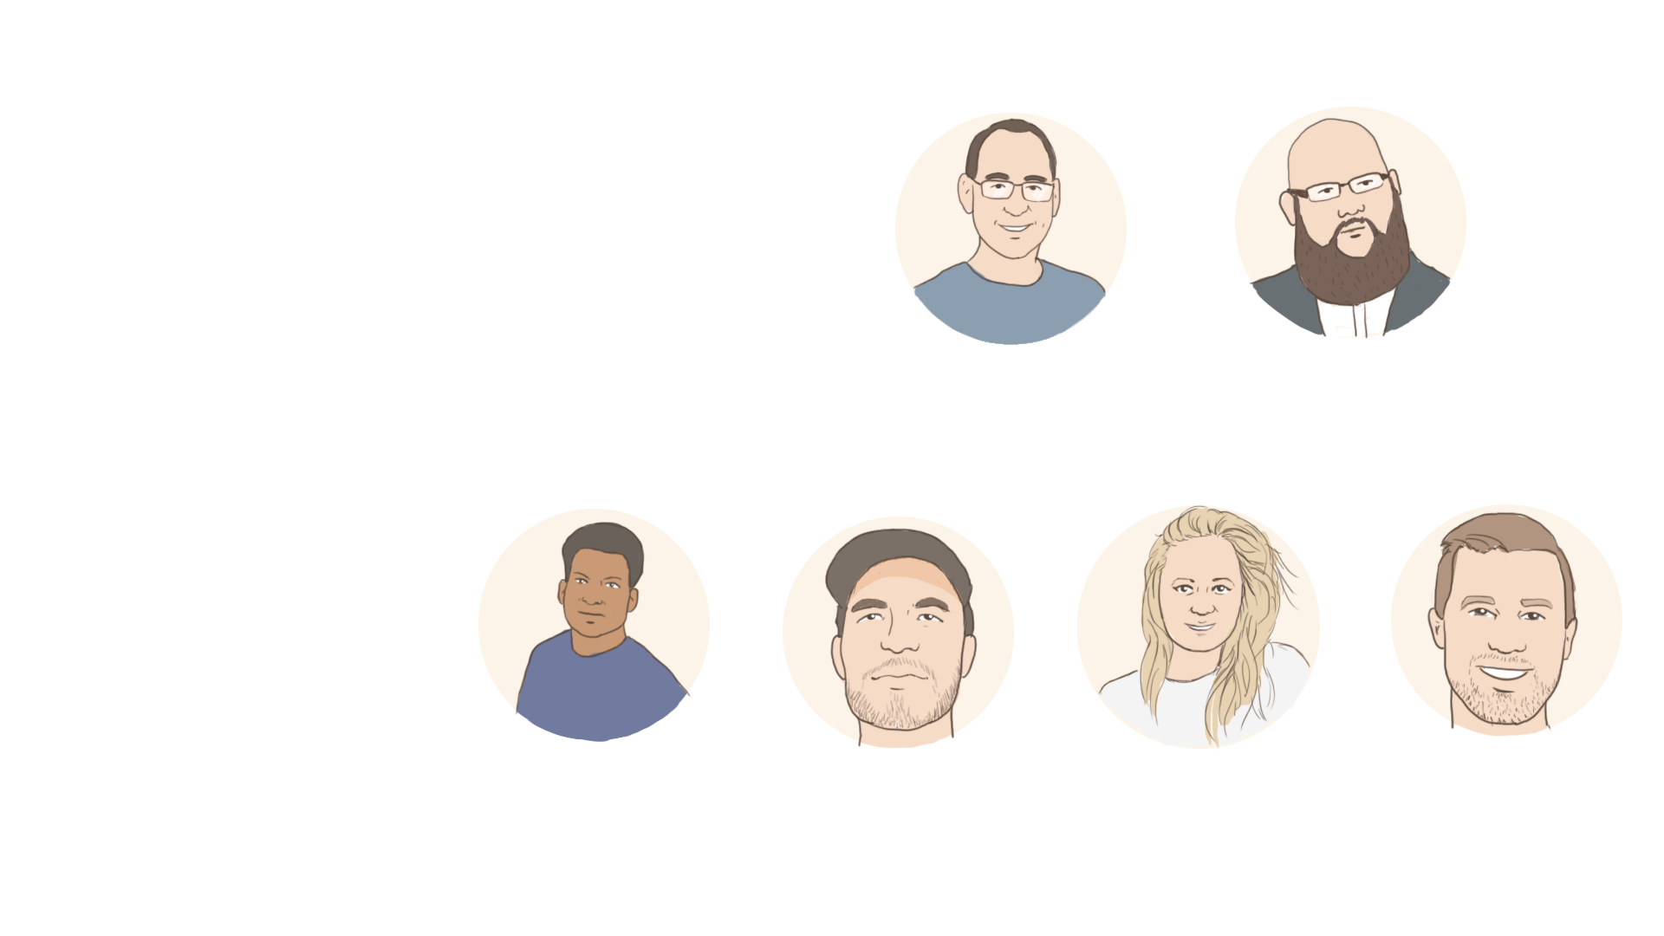


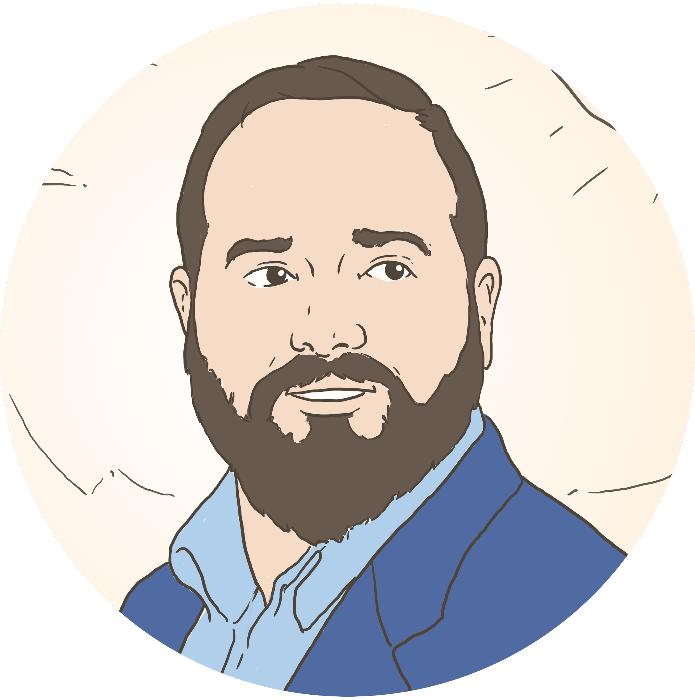

Team
John Paller
Founder
Domain & Adoption
Eddie Pastore
Co-Founder
Strategy & Finance
Adam Dill
CTO
Joshua Lapidus
Membership & Community
Voith Mascarenhas
Lead Developer - Web3
Will Morgan
Finance Steward
Hannah Oreskovich
Communications
Justin Moskowitz
Marketing & Adoption

Slide 16

Why Opolis?
Framework Built: Platform prepared to onboard employees nationally
Currently focused on California, Colorado, Oregon, Tennessee
Web3 Credibility: Founded ETHDenver. 15 top ETH projects collaborating on technology integrations.
Deep HR Experience: Over 35K total W2’s over 10+ years in 36 US states
High Volume Payroll & Benefits: Processed 1400 employees/week & 25MM payroll annually
Exit in HR Space: Built & exited 5th largest staffing firm in Colorado

Slide 17
Raise, Use of Funds & Member Adoption
Raising up to $5M on a Series Seed II Preferred Equity Round. Previously raised $1.1M in Series Seed & $500K in Convertible Notes.
Next 500 Members:
Build to 100 Coalition Members & Landing Pages
Aggressive targeted B2C advertising & marketing campaign (Google Ads, Facebook, Twitter)
Freelancer Pools Targeted Advertising: Github, UpWork, Uber, Lyft, Various Podcasts
Expanding US Footprint:
Invest in compliance requirement for more states to offer services
Hire more development and membership-team resources
Ongoing Tech Buildout: Member onboarding & dashboard live
2021 Roadmap: extend dashboard features, DEO/Guild Governance, invoicing, and third-party integrations

Slide 18

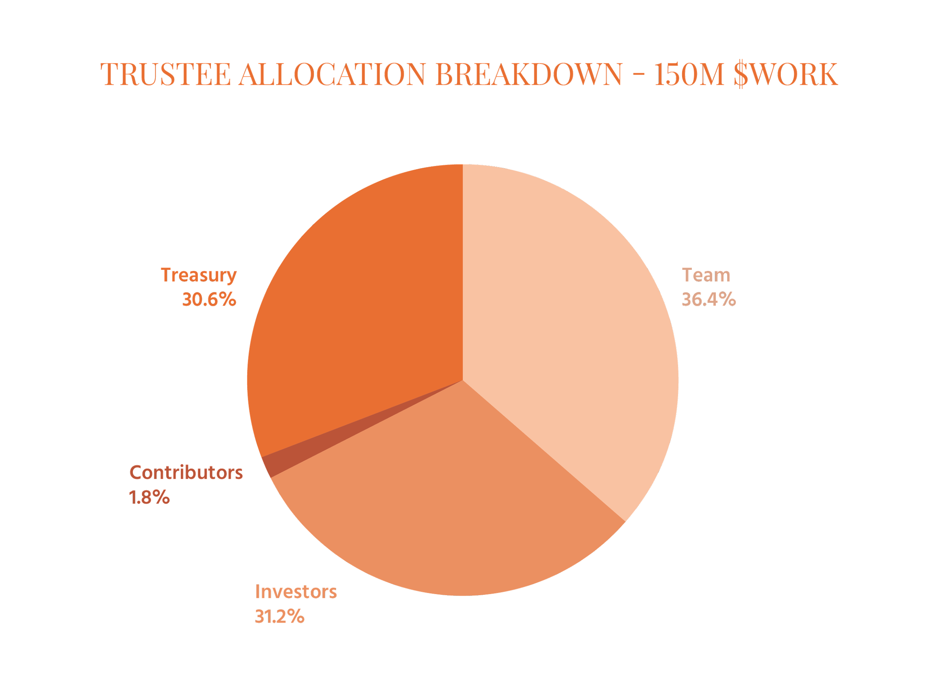
$WORK, Genesis Allocation & Investor Rewards
150M $WORK at the Genesis Allocation (of
315M total) to Trustee
Event 1: 67% immediately allocated to Trustee cap table
20% vested immediately
4 years vesting for remainder
Ally Bonus based on Investment Amount
Event 2: Upon sale or liquidation of Opolis, investors receive pro rata of purchase price
with 1x liquidation preference
Event 3: Investors are entitled to pro rata of remaining Trustee Treasury upon sale/liquidation

Slide 19
$WORK Rewards & Multipliers
NO $WORK ARE SOLD. EXAMPLE BASED ON $25M PRE-MONEY VALUATION.* FULL TOKENOMICS HERE.
Investor Tier | Investor $ | % Equity | Base $WORK | Ally Bonus | Total $WORK | 20% Vested | 4YR Vest
Investor I | 50,000 | 0.16% | 162,598 | 50,000 | 212,598 | 42,520 | 170,079
Investor II | 100,000 | 0.33% | 325,197 | 150,000 | 475,197 | 95,039 | 380,157
Investor III | 150,000 | 0.49% | 487,795 | 300,000 | 787,795 | 157,559 | 630,236
Investor IV | 200,000 | 0.65% | 650,393 | 500,000 | 1,150,393 | 230,079 | 920,315
Investor V | 250,000 | 0.81% | 812,992 | 750,000 | 1,562,992 | 312,598 | 1,250,393
Investor VI | 500,000 | 1.63% | 1,625,983 | 2,000,000 | 3,625,983 | 725,197 | 2,900,787
Investor VII | 750,000 | 2.44% | 2,438,975 | 3,750,000 | 6,188,975 | 1,237,795 | 4,951,180
Lead (FILLED) | 1,000,000 | 3.25% | 3,251,966 | 5,500,000 | 8,751,966 | 1,750,393 | 7,001,573
*Numbers are directional. Valuation is yet to be finalized with investors. Final #’s will be disclosed prior to close.

Slide 20


THE EMPLOYMENT COMMONS
John Paller - Executive Steward
john@opolis.co
@PallerJohn opolis.co
Grab some time on my calendar
Payroll, Benefits, and Shared Services for the Independent Worker
2021

